Slide 1

WU Digital
EUROC – Transaction Review Training
November 2012

Slide 2
Contents
Blaze referred transactions
Reviewing possible fraud scenarios and key elements
Transaction flow
Pre-Auth Blaze responses
Time & Risk segments
AVS & CVV2 response codes
Age variables
Reviewing key data elements

Slide 3




Blaze Risk Engine
Family Fraud
Possible Fraud Scenarios (referred by Blaze)
Identity thefts
Scams
Payment fraud
Card fraud
Lottery scams
Fix IT scams
Account takeover

Slide 4
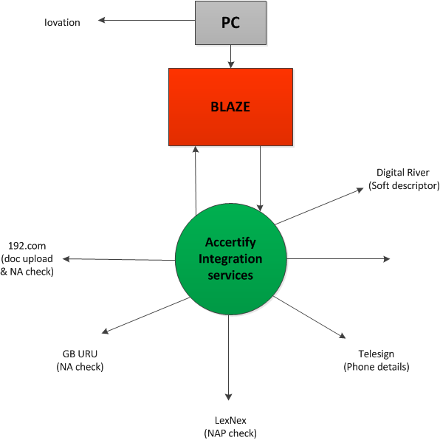
WU Digital Vendors

Slide 5
Key data elements to look on different fraud scenarios
It is important to look through all the key elements while reviewing transactions. However the most important data, that could help to distinguish a certain fraud scenario, is marked in red.
 | Key Data Elements | Account takeover | Card Fraud | Scam | Family Fraud
1 | PaymentAttemptOnlyFlag | ˅ | ˅ | ˅ | ˅
2 | RiskSegmentName | ˅ | ˅ | ˅ | ˅
3 | Time | ˅ | ˅ | ˅ | ˅
4 | PBVActivationProcess | ˅ | ˅ | ˅ | ˅
5 | PBVPinDeliveryMethod | ˅ | ˅ | ˅ | ˅
6 | $0AuthAVSCode | ˅ | ˅ | ˅ | ˅
7 | $0AuthCVVCode | ˅ | ˅ | ˅ | ˅
8 | IovationEvidenceResult | ˅ | ˅ | ˅ | ˅
9 | 3DSecureStatusCode | ˅ | ˅ | ˅ | ˅
10 | Age Variables (columns P to V) | ˅ | ˅ | ˅ | ˅
11 | FinalDispositionReasonCode | ˅ | ˅ | ˅ | ˅
12 | Modcalc_Dist | ˅ | ˅ | ˅ | ˅
13 | Sender info (starting column AV) | ˅ | ˅ | ˅ | ˅
14 | Receiver info (starting column BC) | ˅ | ˅ | ˅ | ˅
15 | OPacket_DFP_IpAddress_Loc_CountryCode | ˅ | ˅ | ˅ | ˅
16 | Machine ID | ˅ | ˅ | ˅ | ˅
17 | IPAddress | ˅ | ˅ | ˅ | ˅
18 | RealIPAddress | ˅ | ˅ | ˅ | ˅
19 | Amount | ˅ | ˅ | ˅ | ˅

Slide 6
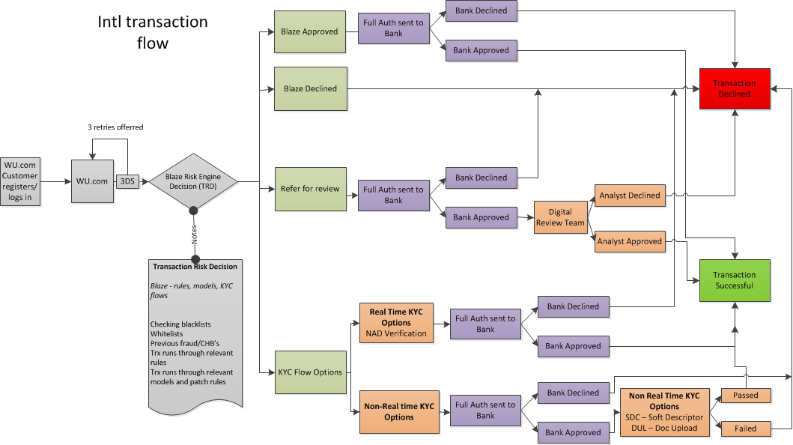

Slide 7
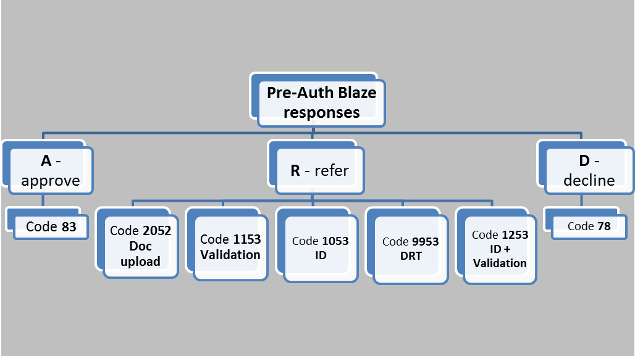
Pre-Auth Blaze responses
After assigning initial disposition for a transaction, Blaze gives post-Auth code and final disposition;
If the bank does not decline a transaction, in most cases pre-Auth would match the post-Auth code.

Slide 8
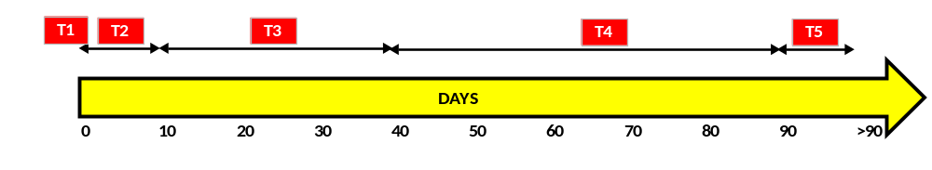
Time segments - indicate a length of day-based interval for a customer that is using WU.com
T1 = 0 Approval Days on Book for this customer → payment fraud, card fraud, family fraud, scam
T2 = > 0 and <= 10 App DOB for this customer → payment fraud, card fraud, family fraud, scam
T3 = > 10 and <= 40 App DOB for this customer → payment fraud, card fraud, family fraud, scam
T4 = > 40 and <= 90 App DOB for this customer → family fraud, scam
T5 = > 90 App DOB for this customer → account takeover, family fraud, scam, identity theft

Slide 9
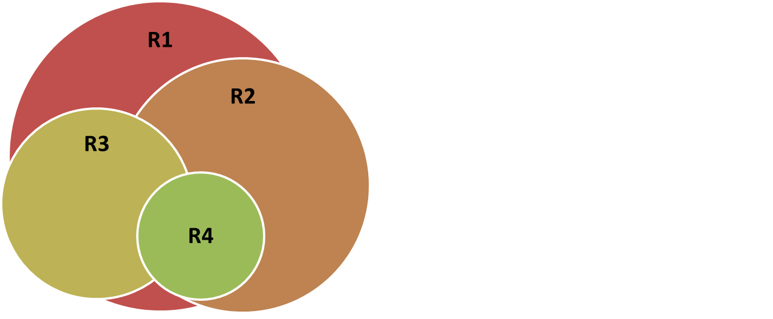
Risk segments – indicate a risk factor for WU.com users.
R1 – high risk customers (usually brand new consumers or those, who make any changes on their profile, device, credit card etc.)
R2 – medium risk customers
R3 – low risk customers (frequent WU.com users, sending to previous receivers or countries, usually using same device details and payment options)
R4 – WU employees, white listed customers

Slide 10
AVS Response Codes for Visa, MasterCard, Discover, and American Express
AVS Code | Meaning | Matched Details
A | Address | Address only (no ZIP code)
B | International “A” | Address only (no ZIP code)
C | International “N” | None
 |  | NOTE:
 |  | The transaction is declined.
D | International “X” | Address and Postal Code
E | Not allowed for MOTO (Internet/Phone) transactions | Not applicable
 |  | NOTE:
 |  | The transaction is declined.
F | UK-specific “X” | Address and Postal Code
G | Global Unavailable | Not applicable
I | International Unavailable | Not applicable
M | Address | Address and Postal Code
N | No | None
 |  | NOTE:
 |  | The transaction is declined.
P | Postal (International “Z”) | Postal Code only (no Address)
R | Retry | Not applicable
S | Service not Supported | Not applicable
U | Unavailable | Not applicable
W | Whole ZIP | Nine-digit ZIP code (no Address)
X | Exact match | Address and nine-digit ZIP code
Y | Yes | Address and five-digit ZIP
Z | ZIP | Five-digit ZIP code (no Address)
All others | Error | Not applicable
Address verification system (AVS) is a tool provided by credit card associations and issuing banks to allow merchants to check the submitted billing address to see if it is on file with the issuing bank.

Slide 11
CVV2 Response Codes for Visa, MasterCard, Discover and American Express
CVV2 Code | Meaning | Matched Details
E | Error - Unrecognized or Unknown response | Not applicable
I | Invalid or Null | Not applicable
M | Match | CVV2CSC
N | No match | None
P | Not processed | Not applicable
S | Service not supported | Not applicable
U | Service not available | Not applicable
X | No response | Not applicable
The CVV2 number is a tool for merchants to verify that the consumer is in
possession of the card. This number is a three- or four-digit number located
either above the credit card number for American Express cards or on
the back for MasterCard and Visa.

Slide 12
AVS and CVV2 Response Codes for Maestro
AVS Code | Meaning | Matched Details
0 | All the address information matched. | All information matched
1 | None of the address information matched. | None
 |  | NOTE:
 |  | The transaction is declined.
2 | Part of the address information matched. | Partial
3 | The merchant did not provide AVS information. Not processed. | Not applicable
4 | Address not checked, or acquirer had no response. Service not available. | Not applicable
Null | No AVS response was obtained. Default value of field. | Not applicable
CVV2 Code | Meaning | Matched Details
0 | Matched | CVV2
1 | No match | None
2 | The merchant has not implemented CVV2 code handling | Not applicable
3 | Merchant has indicated that CVV2 is not present on card | Not applicable
4 | Service not available | Not applicable
All others | Error | Not applicable

Slide 13
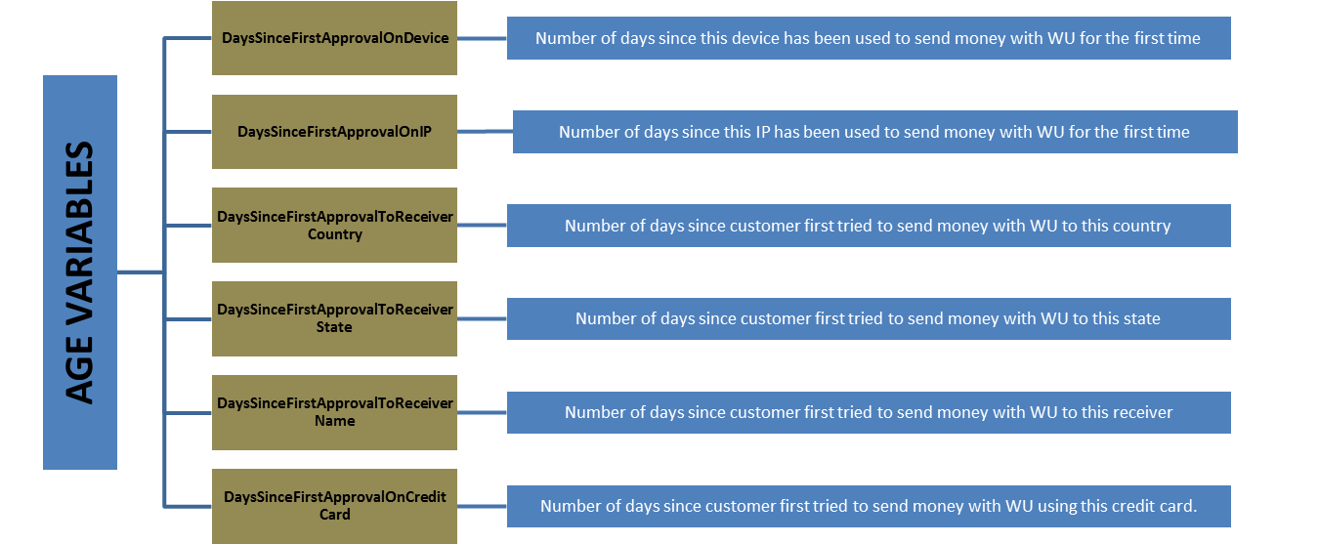
Age variables on referred transactions - show the age of device, IP, receiver or credit card that is being used.

Slide 14
Key Data Elements – most important data segments, that should be checked on every transaction. This order is a recommendation to follow, but it is not mandatory and could vary depending on different fraud scenarios.
Payment Attempt
Iovation Evidence Result
Modcalc Dist
Risk Segment Name
3D Secure Status Code
Sender info (starting column AV)
Time
Age Variables (columns P to V)
Receiver info (starting column BC)
Opacket IpAddress Loc Country Code

Slide 15

Key Data Elements
Payment Attempt
Check transaction history looking if all transactions passed AVS/CVV and look at the time difference between all transactions.
1 – Transaction didn’t pass AVS/CVV;
0 or NULL – Transaction passed AVS/CVV

Slide 16
Key Data Elements
Risk Segment Name
Check the risk segments. This way you can see if the transaction is high or low risk. R3 transactions should be approved by Blaze, so they wouldn’t need a review.
R1 – high risk;
R2 – medium risk;
R3 – low risk;
R4 – WU, Military ISP, white list.

Slide 17

Key Data Elements
Time
Look at the time it takes a customer to complete the transaction on the website from start to finish (starting when logging in).
Average time to send a transaction - 200/300 seconds.

Slide 18
Key Data Elements
Iovation Evidence Result
Check if device has been denied by Iovation, if yes, then search in Iovation. It tells you if the Customer Number or Device has Credit Card Fraud associated with it through Iovation's vendors.
A – No Fraud was detected;
D – Fraud detected.

Slide 19

Key Data Elements
3D Secure Status Code
Did it pass 3D secure or failed?
0/800 – Pass;
0/810 – Pass;
40/850 – Bank not available;
40/830 – Fail.

Slide 20
Key Data Elements
Age Variables (columns P to V)
Looking if it is a new device, new IP, sending to a new place, sending to a new person.
Each time new IP, device, destination, receiver, credit card is used you will see 0.

Slide 21
Key Data Elements
Final Disposition Reason Code
Check what happened to the transaction, why it has been declined, etc.
A – approved; D – declined; C – cancelled;
NULL - Still on hold or we are missing the final decision due to data migration problems.

Slide 22
Key Data Elements
Modcalc Dist
Distance between customer’s registered address and actual IP address location (where the transaction has been sent from).
If the distance is high you should pay attention to this transaction.

Slide 23
Key Data Elements
Sender info (starting column AV)
Did it change? How many times?
Any changes should draw your attention.

Slide 24
Key Data Elements
Receiver info (starting column BC)
Check if there are any inconsistencies
Unusual changes should draw your attention.

Slide 25
Key Data Elements
Opacket DFP IpAddress Loc CountryCode
Check if the BIN country is the same, or where the card has been issued.
Any inconsistencies should draw your attention.

